Slide 1

ReServe
Created by:
Richard Compton (Display)
Mary Shiner (Display)
Kevin Kaminski (Database)
Kelly Kurkowski (Database)
Selena Haidar (Middleware)
Seth Logan (Middleware)
Elias Qumsieh (Middleware)
Sprint 2!
Notes:
Intro

Slide 2
Learning & Testing Xamarin
Researched Microsoft website for assistance
Ran application tests using Android Studio SDK debugger
Ran emulators on Hyper-V
Xamarin similar to Android Studio code
Possible to use both Android & iOS Platforms
MainActivity.cs & MainPage.xaml file
Notes:
Kevin

Slide 3
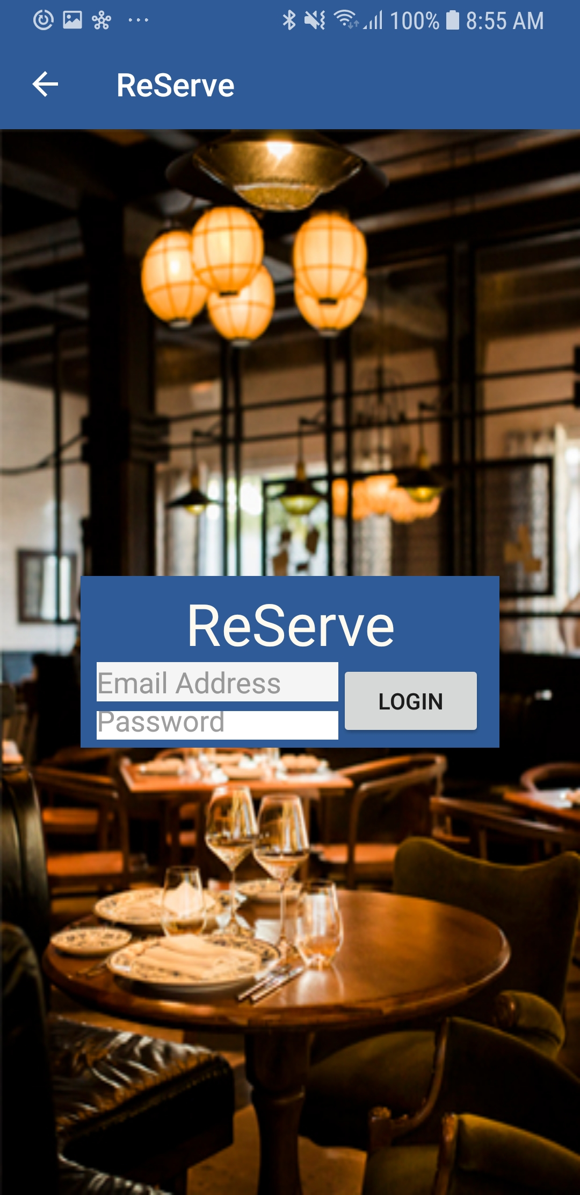
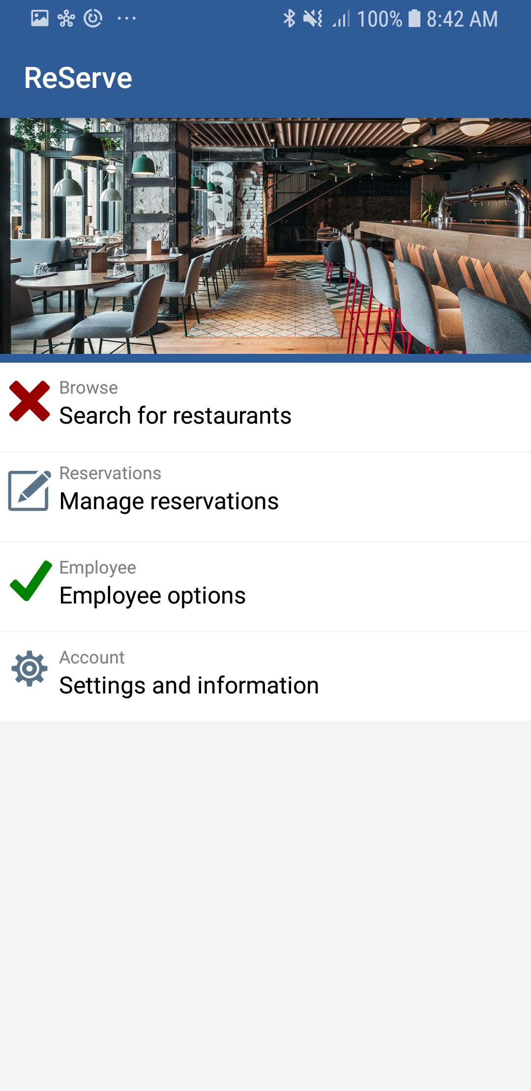
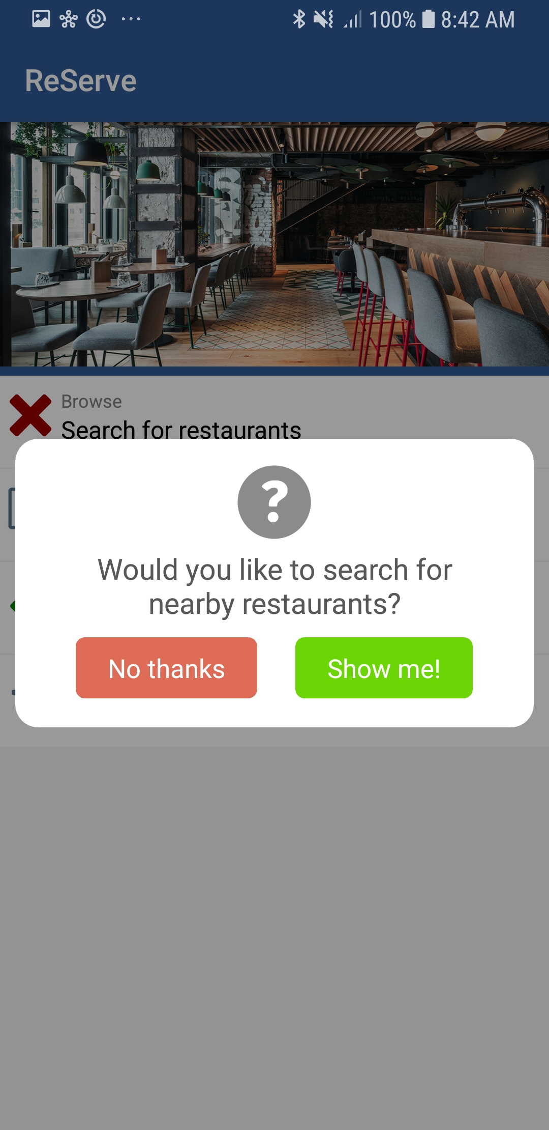
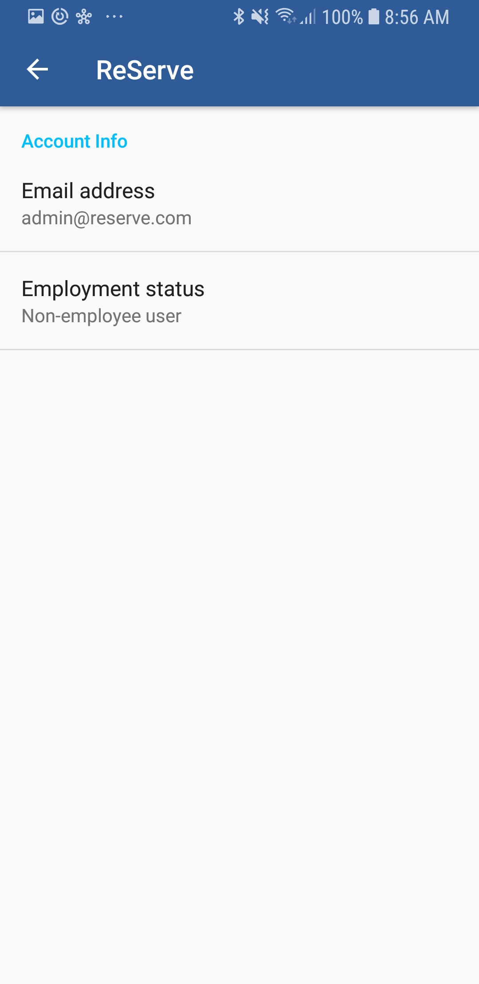
Initial App Design
Notes:
Seth

Slide 4
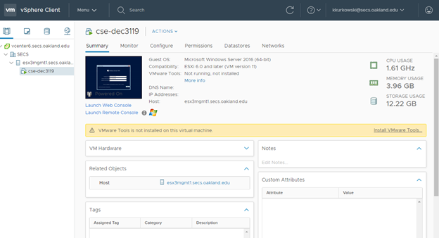
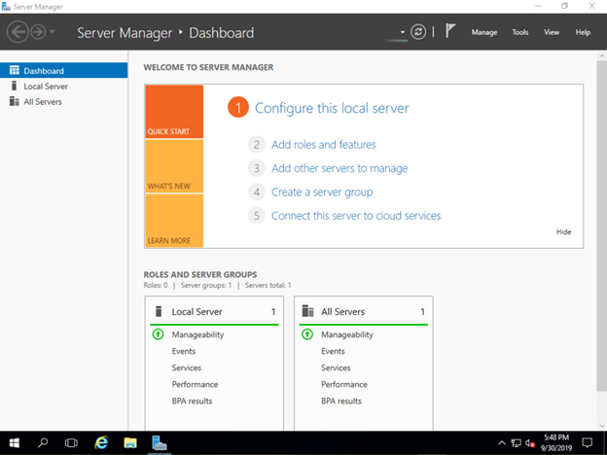
Windows Server
VM provided by school to host our server
Windows Server 2016
Notes:
Kelly

Slide 5
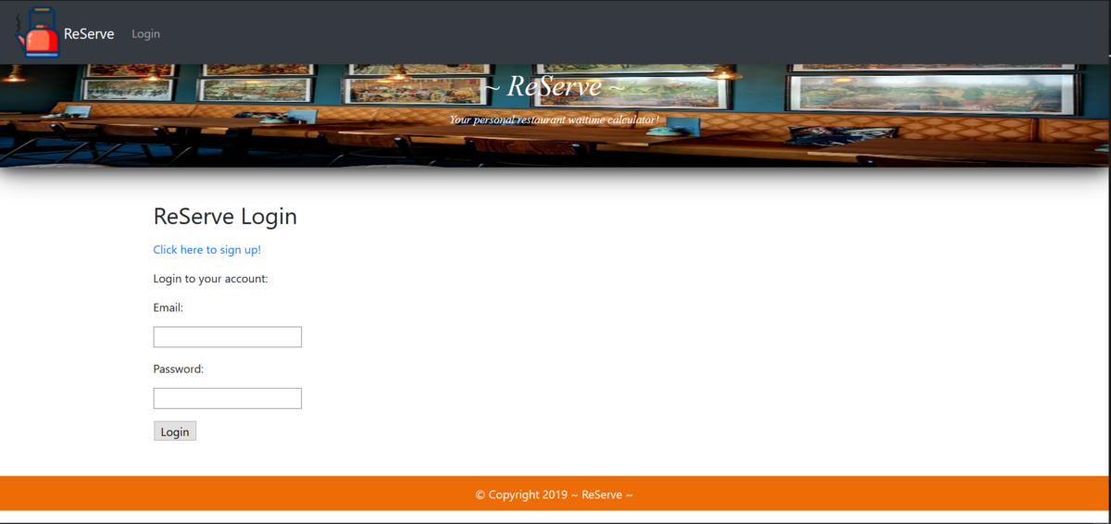
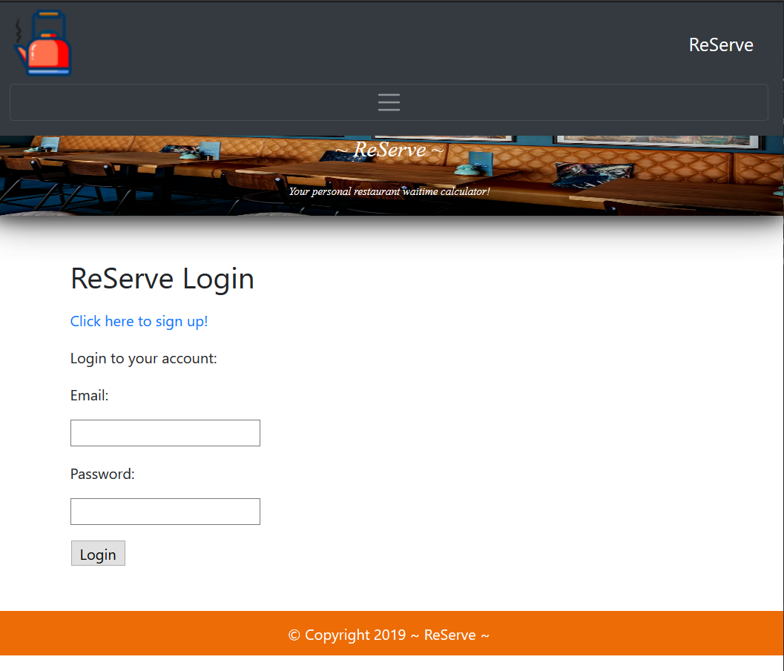
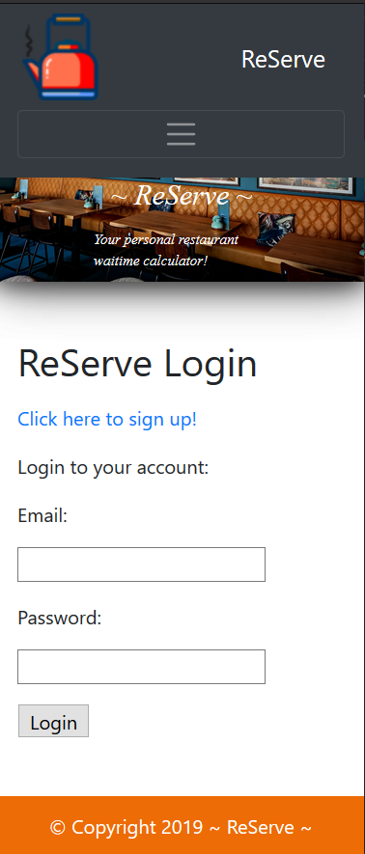
Web Application Navigation
Notes:
Mary

Slide 6
Restaurant Layout Configuration
As a restaurant administrator, I want an easy and quick to use interface to configure my restaurant’s seating area.
Tried multiple approaches
Skeleton finished
Compatibility with C# not yet done
Notes:
RJ

Slide 7
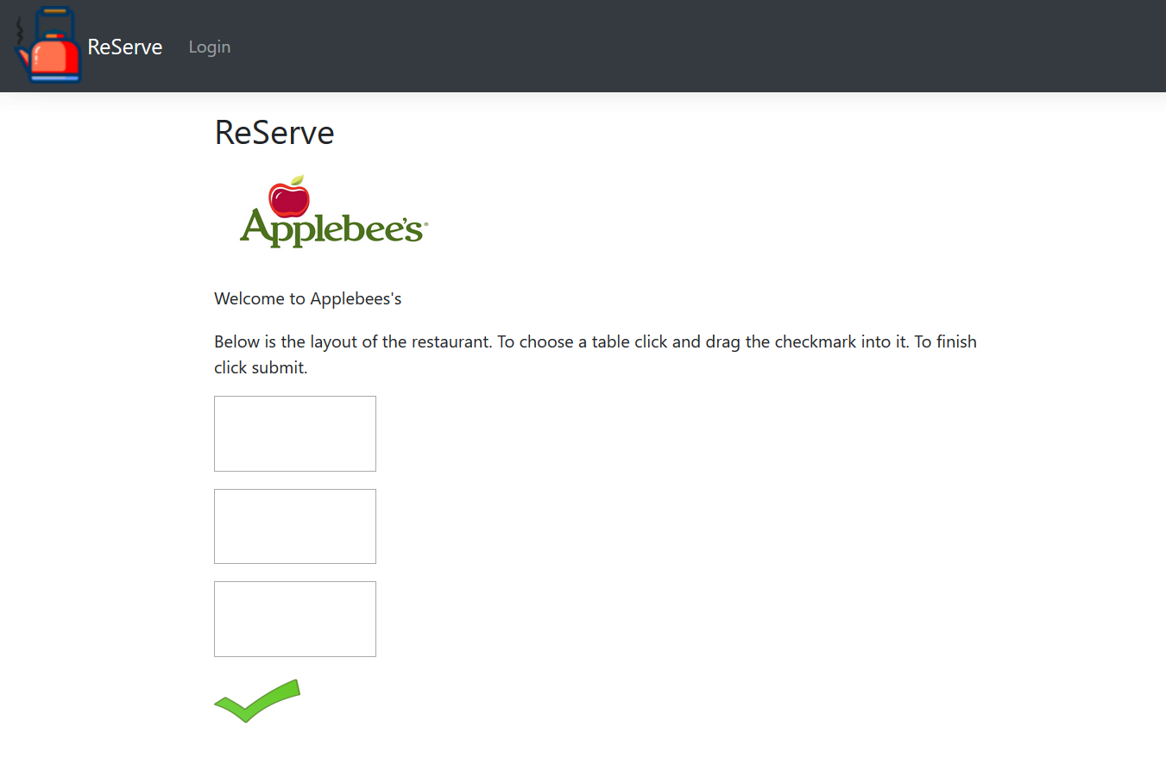
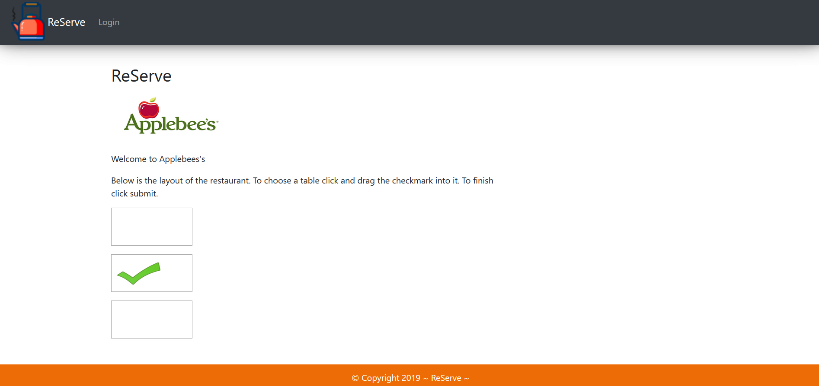
Web Application Drag and Drop
Notes:
Mary

Slide 8
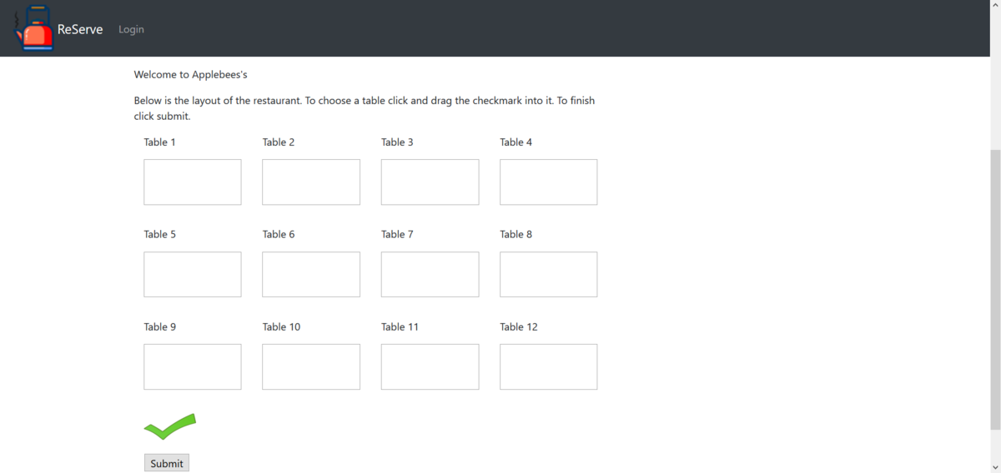
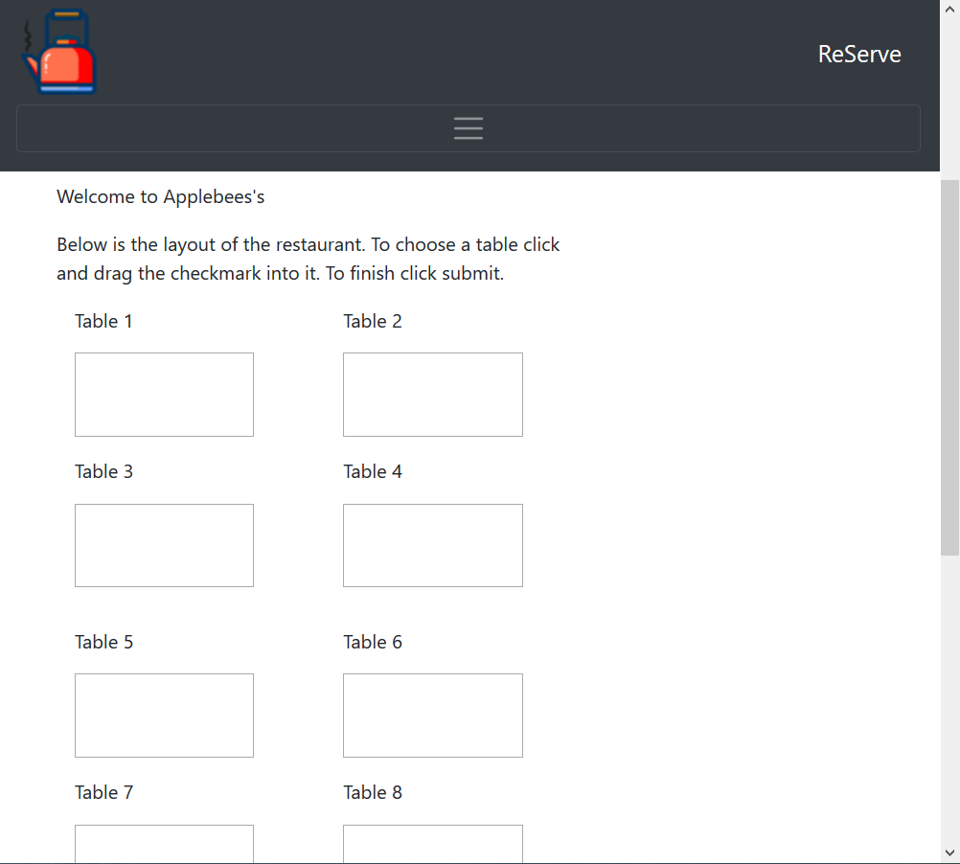
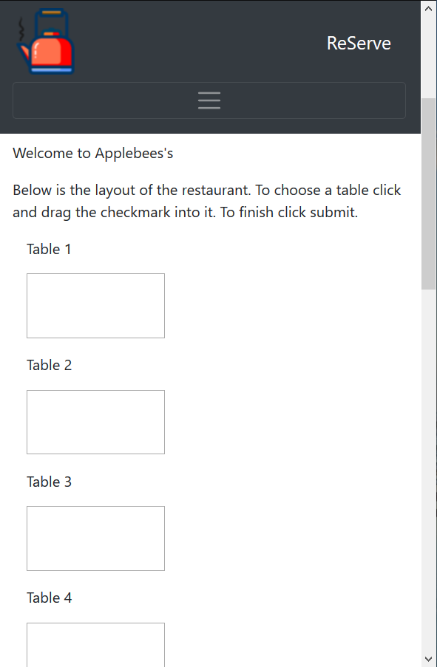
Web Application Drag and Drop
Notes:
Mary

Slide 9
Wait Time Calculation
Variables to consider:
Service rate
Reason for visit
Groups
Data to collect:
Difference of times based on reason for visit
Time it takes for seating, ordering, paying
Scenarios
Large party walk-ins
Reservations
Seating smaller number of people at a table
Notes:
Selena

Slide 10
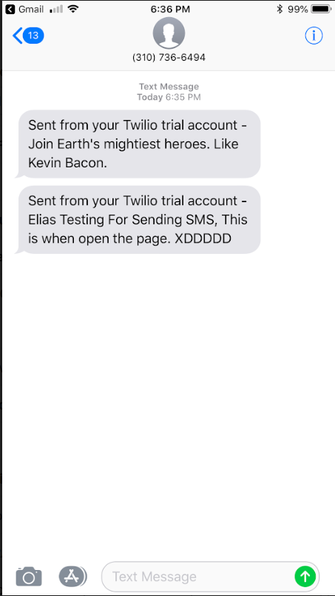
Send SMS & Login Authentication
Installing package for Twilio in Visual studio
Free SMS tool was implemented
Research for Authentication mechanism
Notes:
Elias

Slide 11
Risks and Challenges
Phone app
Xamarin editor is very difficult to use
Lack of experience with mobile app development
Database
Need web API completed to continue development
Server is still not set up so database running locally
Server
Waiting on IT to finish setting up VM
Notes:
Elias

Slide 12
Demonstration Time
Notes:
Demo

Slide 13
Sprint 3 Objectives
As a restaurant administrator, I want an easy and quick to use interface to configure my restaurant’s seating area.
As a restaurant host, I want to quickly calculate the current wait time.
As a general user, I want a wider selection of restaurants to choose from.
Notes:
RJ

Slide 14
Questions?
Notes:
We ask if there are any questions.

